Slide 1


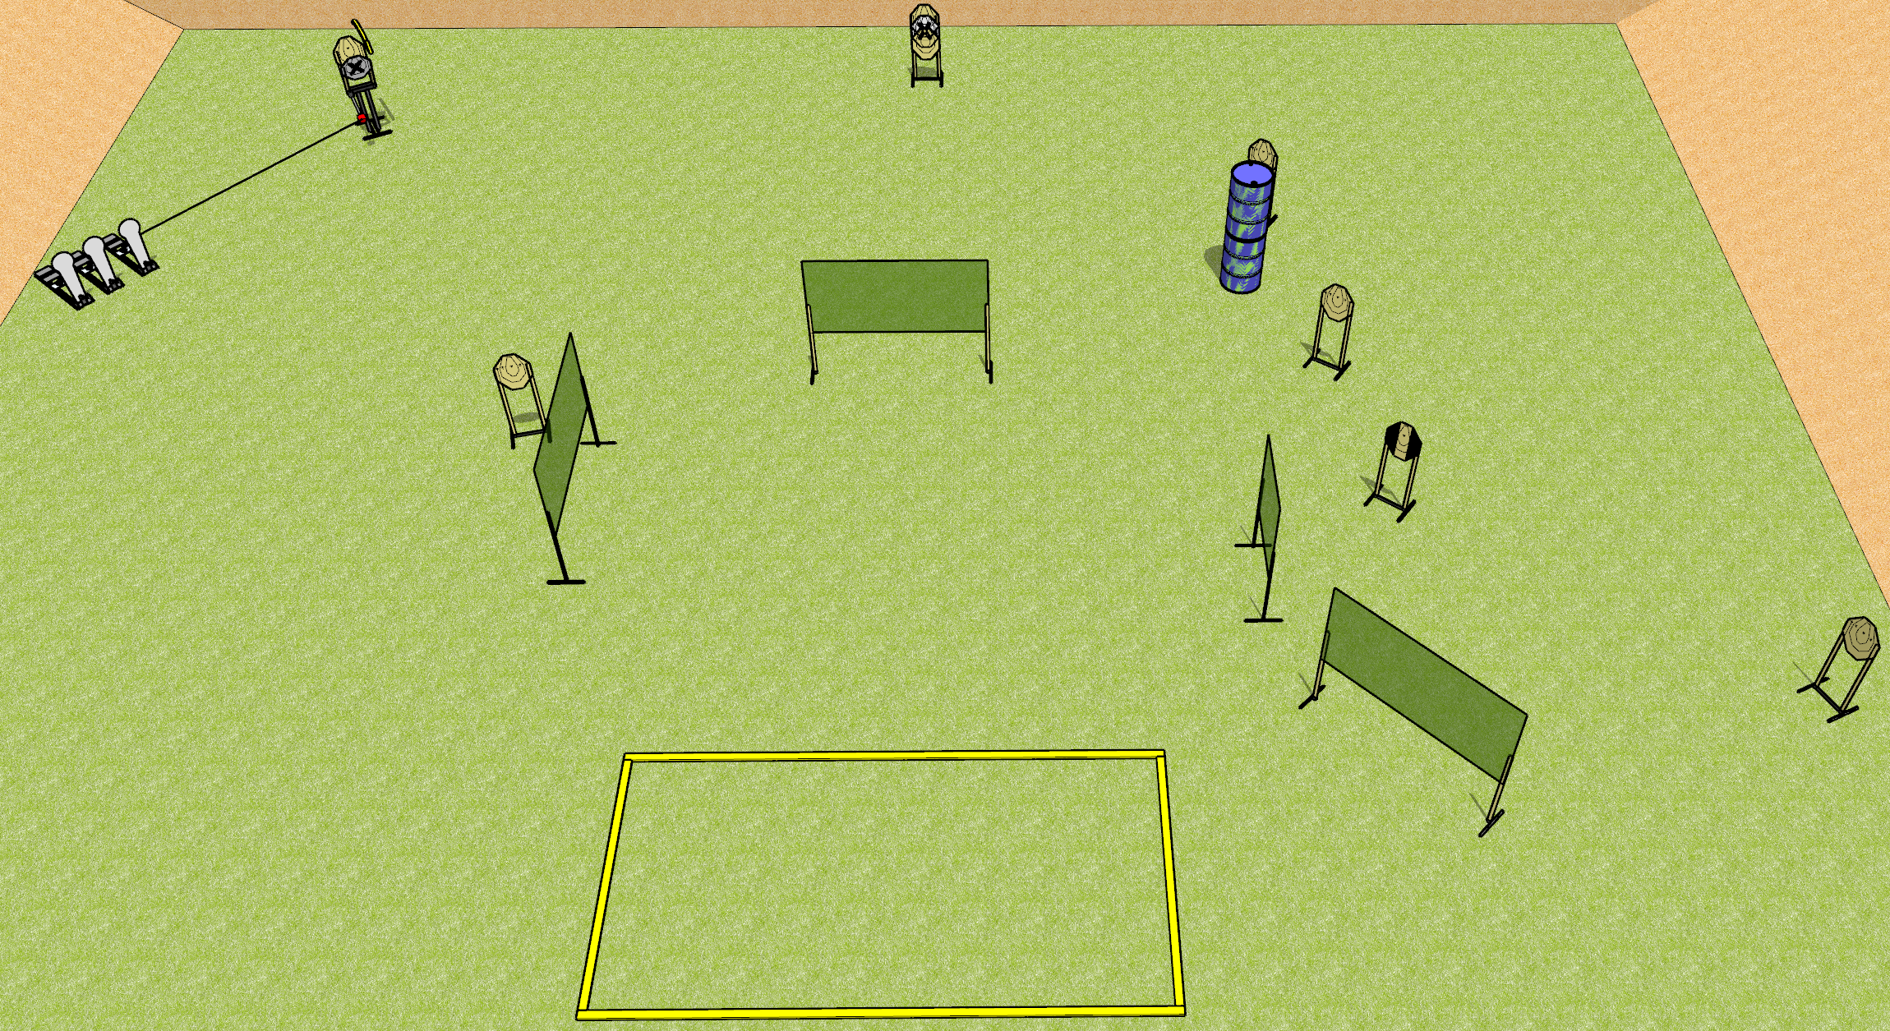
 | Dothan Gun Club – USPSA Match The Other 19 Rounds Course Designer : Drew Coleman
Round Count 19 rounds 8 IPSC 3 Colt poppers
Equipment List 8 wall feet Max trap + activator Shooting area is 20’x10’ 1 tux

Slide 2
The Other 19 Rounds
Written Stage Briefing
The Other 19 Rounds is a 19 round, 95 point, Comstock course of fire. There are 8 IPSC targets and 3 colt poppers. The best 2 hits on paper will score and steel must fall to score. The start signal is audible.
The max trap is activated by the right 2 colt poppers, and is visible at rest. It must be activated before being engaged. Please check the activator prior to walkthrough and set it the same way every time.
Handgun start position is anywhere outside the shooting area, wrists below belt. Handgun is loaded and holstered.
PCC start position is anywhere outside the shooting area, stock on belt. Loaded carbine is held with both hands, safety on.
On start signal, engage targets as they become available from within the shooting area.

